Slide 1
Air Canvas Project Presentation
Reporter

Slide 2
01
Introduction to the Project
Table of Contents
02
Objectives and Goals
03
Tools and Technologies
04
Methodology
05
Future Scope and Challenges

Slide 3
1 Introduction to the Project
01

Slide 4
Overview of Air Canvas
Project Title
Subtitle and Scope
Brief Introduction
Air Canvas Project: This title signifies the innovative nature of a digital drawing application that harnesses advanced technology to create a hands-free experience for users, elevating their creativity without traditional constraints.
Hands-Free Drawing Using Computer Vision: This subtitle clarifies the primary objective of the project, focusing on enabling users to draw digitally through gesture recognition, making the innovation accessible and user-friendly.
The Air Canvas Project leverages computer vision and gesture recognition technology to transform the way people draw digitally. Using Python along with libraries like OpenCV and Mediapipe, it creates a seamless, hands-free drawing experience that can engage users of all ages.

Slide 5
Problem Statement
Limitations of Traditional Drawing
Accessibility Issues
Interactive Experience Need
Traditional digital drawing methods often require physical interaction with devices like tablets or styluses, which can decrease creative flow and impede spontaneous artistic expression, especially for those with disabilities.
Many users struggle with the physical demands of conventional drawing tools, making it challenging for individuals with mobility impairments or those who find it difficult to use standard input methods to engage in digital art creation.
There is a growing demand for an interactive, immersive drawing experience that promotes creativity and allows users to express themselves freely without the limitations posed by traditional digital interfaces.

Slide 6
Objectives and Goals
02

Slide 7
Project Objectives
Real-time Drawing Development
Gesture Recognition Implementation
Intuitive Controls Explanation
To create a digital drawing application that allows users to see their artwork evolve in real-time as they make gestures, thus promoting an engaging creative experience without delay.
The project aims to incorporate sophisticated gesture recognition capabilities that track hand movements and translate them into drawing actions, ensuring a natural and responsive interaction.
To develop an intuitive control scheme enabling users to easily navigate the application, adjust colors, and erase drawings through simple hand gestures, promoting ease of use for all ages.

Slide 8
Expected Outcomes
User Engagement
Drawing Experience Enhancement
With the implementation of a hands-free drawing app, user engagement is expected to significantly increase as individuals can experiment creatively without the constraints of traditional drawing tools.
The anticipated outcomes include an enhanced drawing experience characterized by greater freedom of expression, allowing users to create art more fluidly and spontaneously than ever before.

Slide 9
Tools and Technologies
03

Slide 10
Software and Libraries
OpenCV and Its Features
Python Overview
Introduction to Mediapipe
OpenCV, an open-source computer vision library, offers powerful tools for image processing and video analysis, making it essential for implementing real-time drawing capabilities in this project.
Python is a versatile programming language that provides simplicity and efficiency for developing the Air Canvas Project, enabling rapid prototyping and integration of various libraries.
Mediapipe is a cross-platform framework that facilitates building perception pipelines, particularly for gesture recognition. It enhances the project's capabilities by providing robust solutions for hand tracking and pose estimation.
01
02
03

Slide 11
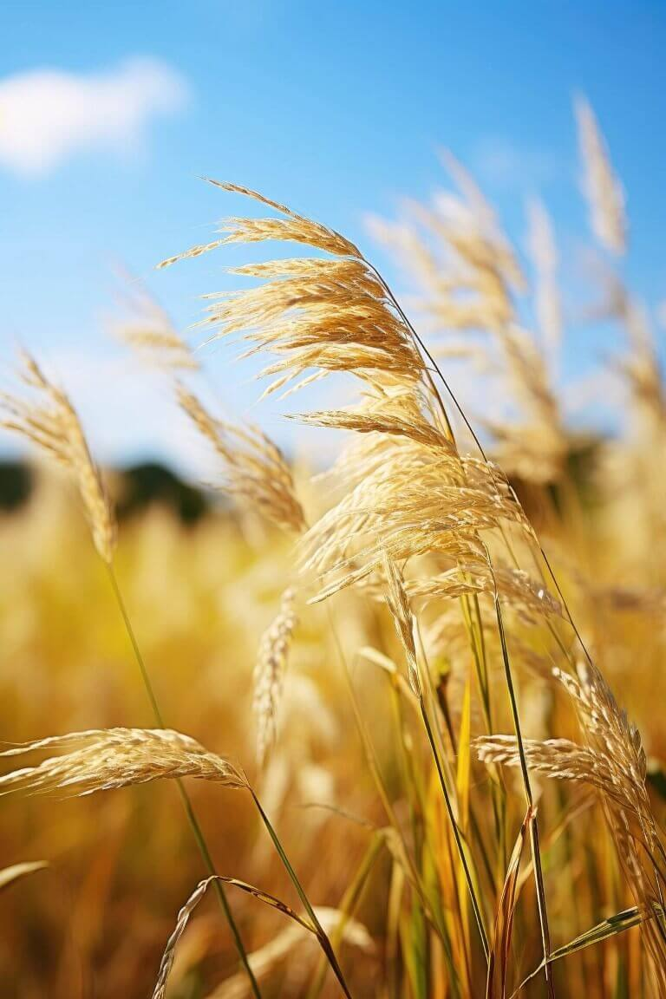
Color Detection Techniques
HSV Color Space Utilization
Advantages of Color Detection
The application utilizes the HSV (Hue, Saturation, Value) color model for more accurate color detection during drawing, allowing users to select colors intuitively without being hindered by the limitations of the RGB space.
By employing effective color detection techniques, users can experience greater precision in their artwork, facilitating a smoother and more enjoyable drawing process while reducing errors.

Slide 12
Methodology
04

Slide 13
Development Steps
01
02
03
Color Detection Process
Contour Detection Mechanism
Gesture Recognition Techniques
The color detection process involves capturing frames from a video feed, converting them into the HSV color space, and implementing algorithms to detect and track selected colors effectively in real-time.
Contour detection algorithms are employed to identify the edges of drawn shapes or hand gestures, enabling the system to recognize specific drawing actions and respond accordingly.
Various techniques for gesture recognition are utilized, including machine learning models that analyze hand movements, ensuring that different gestures can be accurately interpreted to execute corresponding drawing actions.

Slide 14
Optimization Strategies
01
02
Region-of-Interest (ROI) Application
Multithreading for Performance
The project optimizes performance by focusing processing resources on specific areas within the video frame, which enhances the accuracy of gesture recognition while reducing computational load.
Multithreading techniques are incorporated to handle multiple tasks simultaneously, such as processing video input and managing drawing actions, ensuring real-time responsiveness and a smooth user experience.

Slide 15
Future Scope and Challenges
05

Slide 16
Future Enhancements
AI-Powered Gesture Recognition
Future iterations of the project are envisioned to integrate AI-driven gesture recognition systems that enhance accuracy and adaptability, allowing for complex gesture commands to be recognized more effectively.
Multi-color Drawing Support
Expanding functionality to support multi-color drawing will allow users to select and switch between various colors seamlessly, enriching their creative possibilities when using the application.
Mobile and Web Versions Exploration
Future development may explore creating mobile and web versions of the application, making it more accessible and allowing users to draw anytime and anywhere on different devices.

Slide 17
Challenges Faced
Lighting Conditions Issues
Background Noise Complications
Gesture Misinterpretation Problems
The application faces challenges relating to varying lighting conditions, as inconsistent ambient light can hinder accurate color detection and gesture recognition during use.
Background noise, whether visual or auditory, can disrupt the gesture recognition process, making it crucial to enhance the system's ability to filter out irrelevant data.
Occasionally, gestures may be misinterpreted due to similarities in hand movements, creating a need for continuous refinement of the gesture recognition algorithms to improve accuracy and responsiveness.

Slide 18
Thank you for watching.
Reporter

